Slide 1
Power Electronics
AC VOLTAGE CONTROLLERS
DEPT. OF ELECTRICAL ENGINEERING, COLLEGE OF ENGINEERING TRIVANDRUM

Slide 2









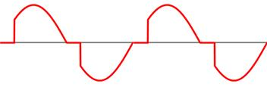

AC Voltage Controllers
Converts Fixed AC Voltage to Variable AC Voltage
Thyristor based controller
Two Types of Control
Phase Control
Conduction take place in a portion of each half cycle, starting from a specific phase angle (firing angle)
Integral Cycle Control
Conduction takes place for integral number of full cycles and turn off for further number of cycles.
Used in systems with large time constant

Slide 3
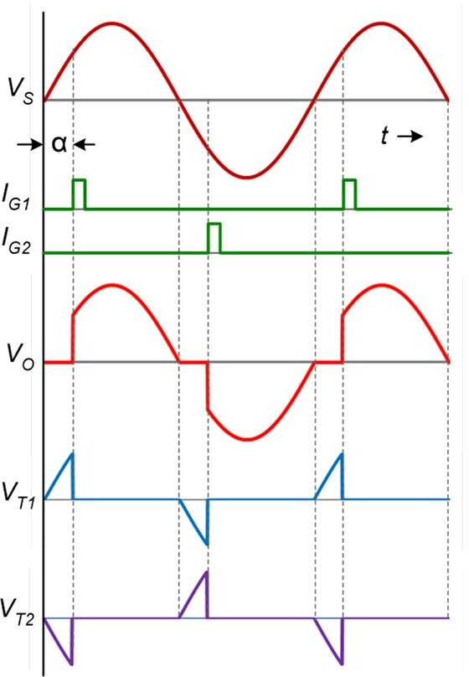



Basic Controller with R Load
1
⎤ 2
⎥⎦
1
2
⎡ 1
π
⎡
V
2
sin 2ωt
π
⎤
⎢_{⎣π} ∫_{α}
2
V
=
V sin² ωt. dωt
= ⎢
m
ωt −
⎥
α ⎥⎦
O( RMS )
m
⎢⎣ 2π
2
1
2
₌ V_{m} ⎡ 1
⎛
sin 2α ⎤
_{2 ⎢π} ⎜
(π − α )+
⎞
⎟⎥
⎣
⎝
2
⎠⎦
₌ ^{V}O( RMS )
_{Input PF =} Output Power ₌ P_{O}
I
O( RMS )
R
Input VA
V_{S} × I_{O}

Slide 4

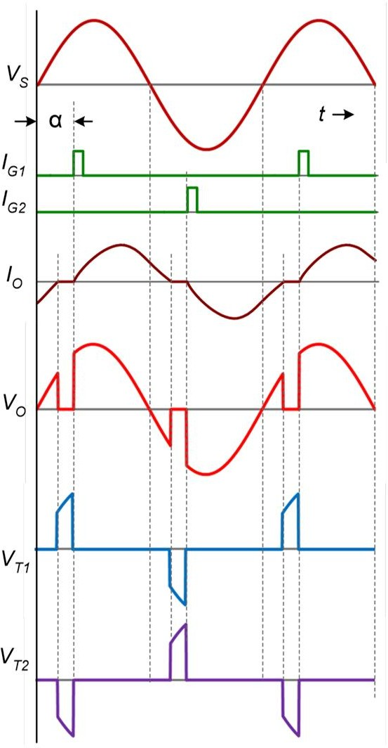





Basic Controller with RL Load
Output current extends beyond the zero crossing point of input voltage
Output voltage follows input as long as current is present
Control may not be possible with highly inductive loads

Slide 5











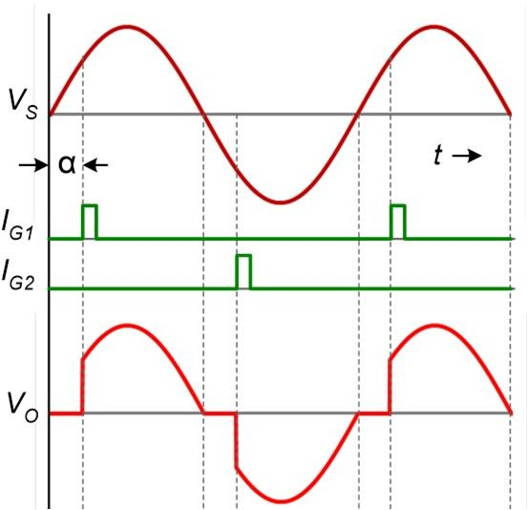
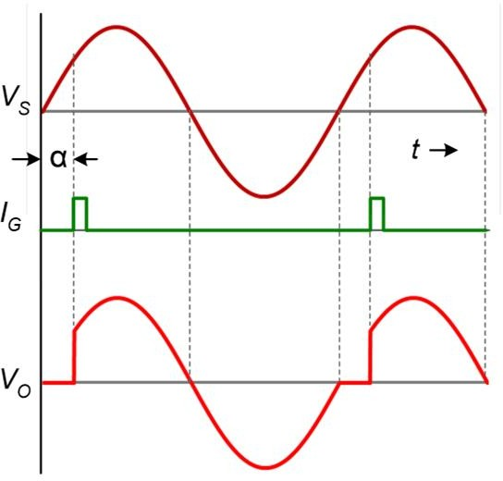
Full Wave an Half Wave controller
sin 2α ⎤
2
1
2
sin 2α ⎤
2
1
2
₌ V_{m} ⎡ 1
⎛
( )
⎞
₌ V_{m} ⎡ 1
⎛
( )
⎞
V
₂ ⎢_{π} ⎜
π − α +
⎟⎥
V
2π − α +
⎟⎥
O( RMS )
⎝
⎠⎦
O( RMS )
2 ⎢ 2π ⎜
⎣
⎣
⎝
⎠⎦

Slide 6




Controller Types
TRIAC connection
Employs one triac only
Suitable for low power applications
Isolated trigger circuit is not necessary
MT2
MT1
V_{S}
V_{O}

Slide 7
Example
A single phase full wave ac voltage controller has input voltage of 240 V, 50 Hz and a load resistance of 20 ohms. The delay angle of thyristors is 60 degrees. Determine the rms output voltage, input power factor and average and rms current in each thyristor.
sin 2α ⎤
2
1
2
₌ V_{m} ⎡ 1
⎛
( )
⎞
V
₂ ⎢_{π} ⎜
π − α +
⎟⎥
O( RMS )
⎣
⎝
⎠⎦
1
⎡
⎛
sin 2 × ^{π ⎞⎤ 2}
₌ 2 × 240 ⎢ 1 ⎜⎛_{π −} π ⎞ ₊
₃ ⎟⎥
V
⎢_{π} ⎜⎜
₃ ⎟
⎟⎥
= 215.3 V
O( RMS )
2
⎢
⎜⎝
⎝
⎠
2
⎟⎥
⎢⎣
⎠⎥⎦
P_{O =} V_{O} I_{O =} V_{O}
V_{S} I_{S} V_{S} I_{S} V_{S} 240
Power Factor =
= ^{215.3} = 0.897

Slide 8
(1+ cosα ) = ^{2 × 240 ⎛}1+ cos ^{π ⎞} = 4.05A
Average current in one thyristor,
V_{m}
2π R
I =
T (ave)
⎜ ₃ ⎟
2π R
⎝
⎠
RMS current in one thyristor,
1
₌ V_{m} ⎡π − α ₊ sin 2α ⎤ ²
I
_{R} ⎢⎣ ⎥⎦
T ( rms )
4π
8π
⎡ π − ^{π} sin 2 × ^{π ⎤ 2}
1
2 × 240 ⎢
3 ₊
₃ ⎥
=
⎢
⎢
⎣
⎥
⎥
⎦
= 7.61 A
20
4π
8π

Slide 9
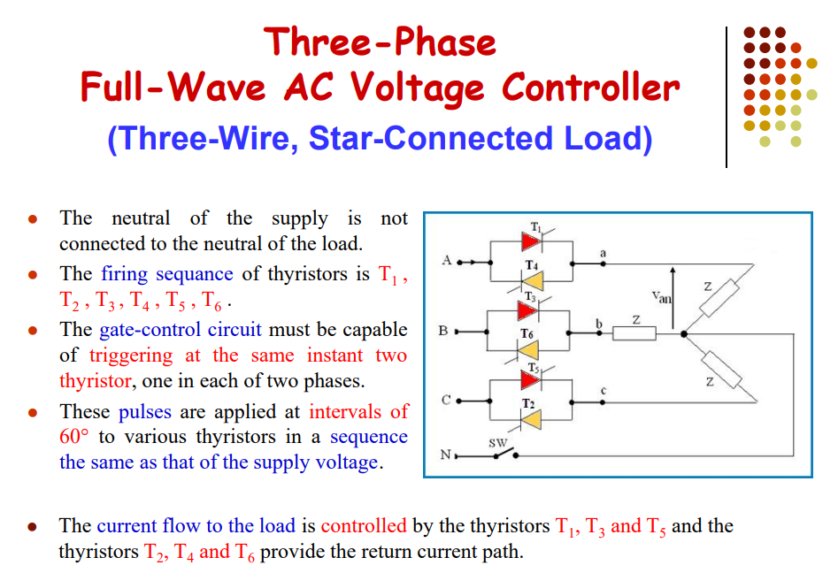

Slide 10
